Slide 1
Solihull’s Net Zero Action Plan
Ann-Marie Attfield

Slide 2
What we are going to cover
Context: The Climate Emergency, Net Zero, Targets
The Net Zero Action Plan
Next steps with the plan
Ongoing actions
Some tips and tricks and where to go for support.

Slide 3
Context

Slide 4
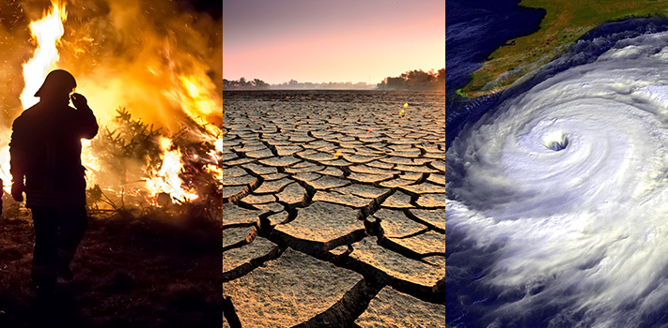
The Climate Emergency
The scientific consensus that humans are altering the climate has passed 99.9%
This is now similar to the level of agreement on evolution and plate tectonics

Slide 5
Climate Change in the UK
Warmer and wetter winters
Hotter and drier summers
More frequent and intense weather extremes
Heatwaves are a risk to public health, can damage buildings and impact transport.
Increased rainfall and flooding including flash floods.
Coastal Flooding – increased flooding in low lying areas.
Impacts on farming, available crops and growing seasons.
How will the Climate Change?
Impacts of Climate Change

Slide 6
Ambitions

Slide 7
What is Net Zero?
Net zero means that total greenhouse gas (GHG) emissions are equal to or less than the emissions removed from the environment.
This can be achieved by a combination of emission reduction and emission removal

Slide 8
Climate Change Ambitions
Globally – Paris Agreement
Well below 2°C
UK Target
Net Zero by 2050
West Midlands
Net Zero by 2041
Pursue 1.5°C
Solihull
Borough wide 2041
Net by 2030 for the Council’ own operations

Slide 9
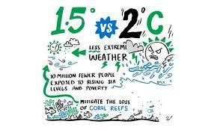
Why is 1.5°C important?
The world will see serious climate impacts at 1.5°C. But after that it gets much worse. The difference between 1.5°C and 2°C is…
The difference between 70% or 99% of coral reefs dying.
Double the likelihood that insects, vital pollinators, lose half their habitat.
Ice-less summers in The Arctic Ocean once per century or once per decade.
1 meter added in sea-level rise.
6 million or 16 million affected by sea-level rise in coastal areas by the end of this century.
UN EP

Slide 10
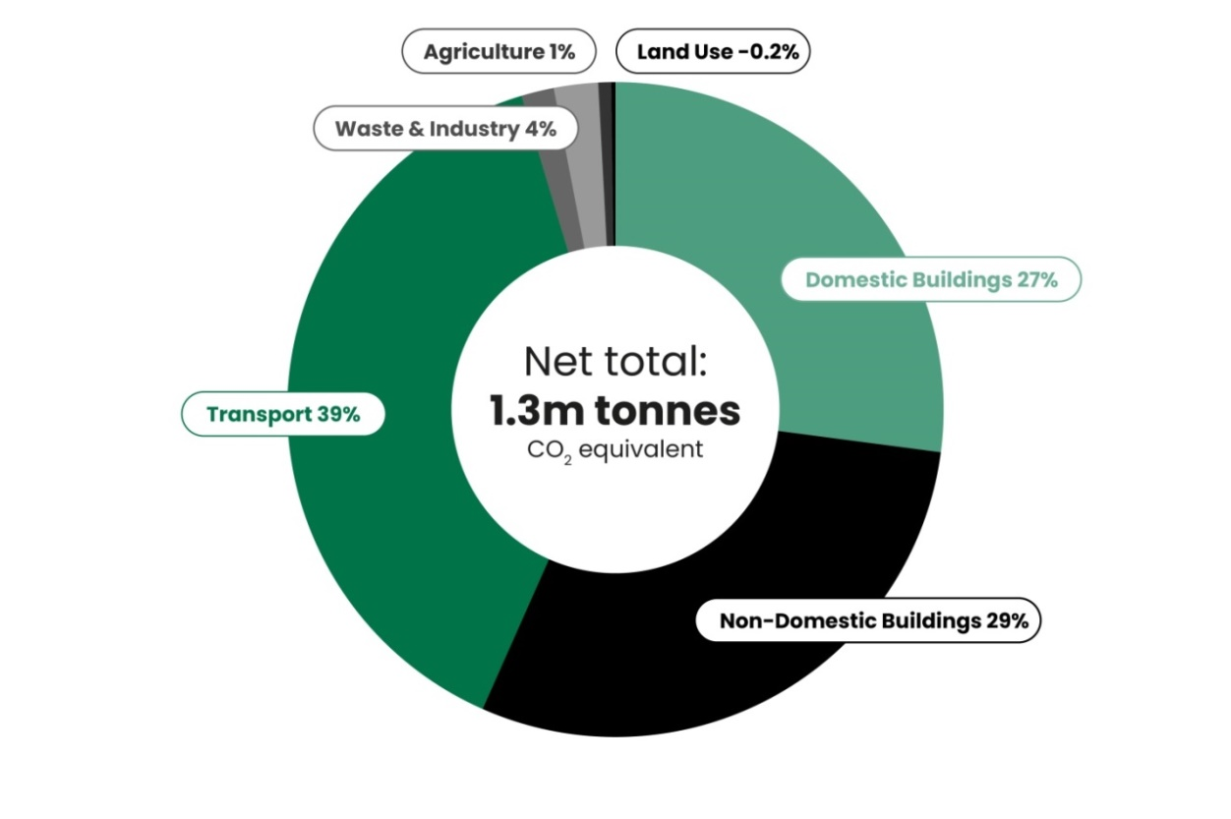

Solihull’s Approach to Net Zero
Target
Challenge
Approach
Borough Wide:
Net Zero by 2041
Council Operations:
Net Zero by 2030

Slide 11
The Challenge

Slide 12
The Challenge

Slide 13
The Challenge
Some Key Challenges
Efficient, warmer, greener Homes
Ensure new developments support net zero
Active Travel and Public Transport
Moving to cleaner vehicles – EV’s alternative technology
Ensuring the right infrastructure is in place
Ensuring Community Involvement
Funding and Financing
We don’t have all the answers yet!
Behaviour Change and Engagement

Slide 14
Developing the Plan

Slide 15
Key Principles
Response to the Climate Emergency
Green recovery
Low Carbon Innovation
Just transition to net zero
Zero carbon growth
Low carbon sector, green jobs and skills
Maximise Co-Benefits

Slide 16
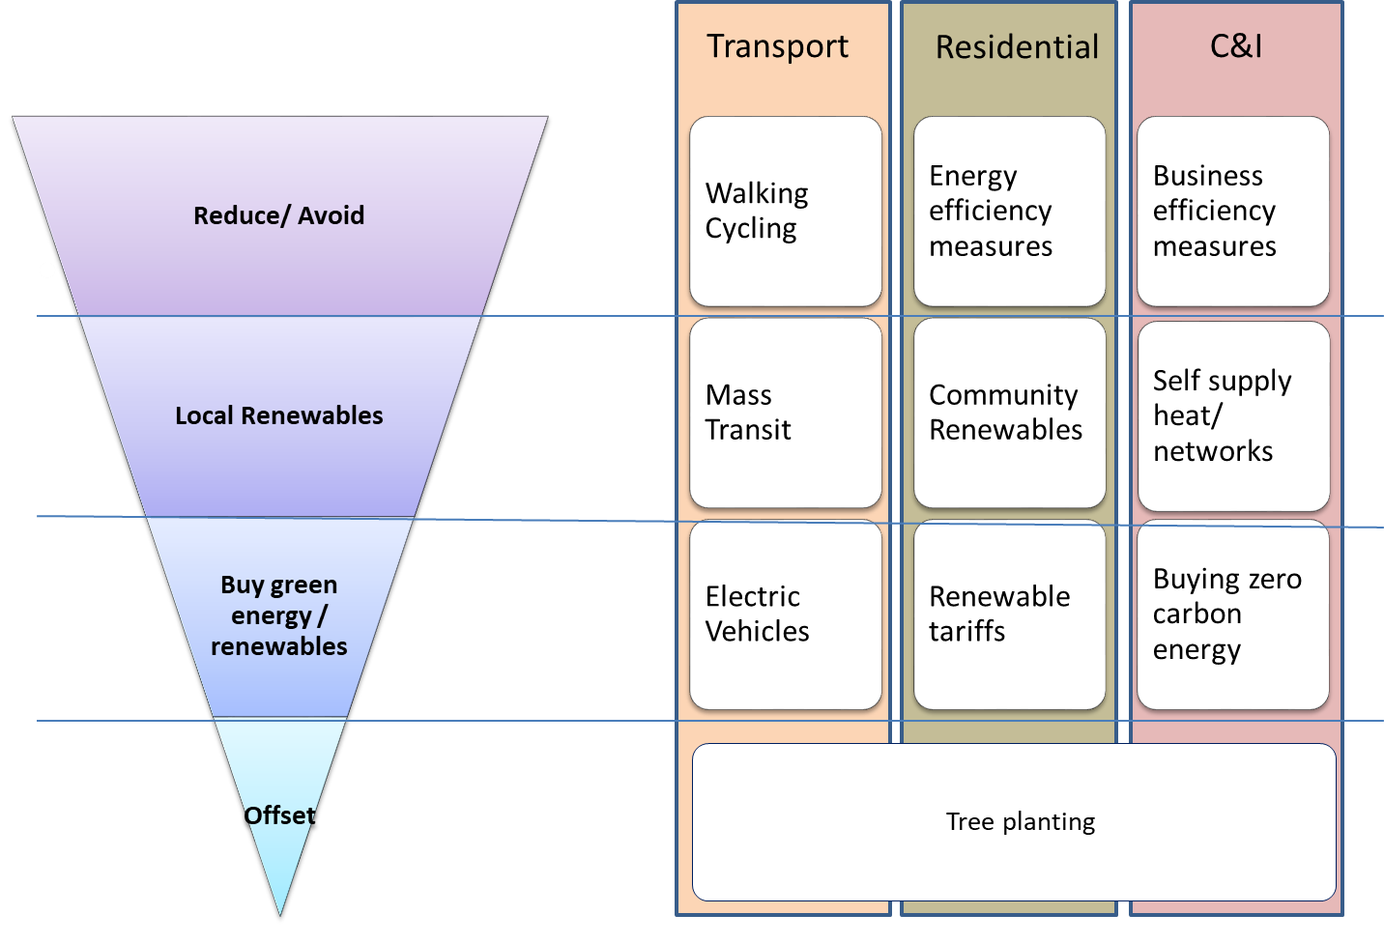
Climate Action taking a priority based approach.

Slide 17






Net Zero Action Plan
On 11th November the Council approved Solihull’s Net Zero Action Plan
The plan is a key part of our response to the climate emergency it identifies the actions that can help us in our journey to net zero.
The Plan Contains:
54 Goals
203 Actions
It covers everything from implementation of technology to a wide range of behaviour change and engagement actions
Action Areas

Slide 18
What is in the plan?
Sector​ | Description of actions​ | Number of goals and actions​
Buildings​ | Includes actions across non-domestic and domestic building types ​ | 13 goals, 52 actions, including 29 key actions​
Transport​ | Includes actions across active travel, electric vehicle uptake, public transport and commercial journeys ​ | 13 goals, 53 actions, including 26 key actions ​
Waste​ | Includes reducing waste and increasing recycling​ | 6 goals, 27 actions ​
Industry​ | Includes advancing low carbon technologies and industry support​ | 2 goals, 6 actions ​
Natural Environments​ | Includes actions relating to tree coverage, land use management and offsetting ​ | 7 goals, 29 actions, including 6 key actions​
Energy Supply​ | Includes actions across understanding of feasibility of renewable technologies, and increasing renewable installations​ | 6 goals, 17 actions, including 5 key actions​
Council Influence ​ | Includes key actions for SMBC to deliver relating to procurement and Council behaviour change​ | 7 goals, 19 actions, including 7 key actions ​

Slide 19
Next Steps

Slide 20
Next Steps: Implementation
Agreeing a Net Zero Action Plan is just the start. The challenge now will be to focus on implementation and ensuring our transition to Net Zero is fair to everyone in Solihull.
Our NZAP will be reviewed every three years or earlier depending on legislation and new technology, and there will be regular progress reports and updates
https://netzerosolihull.co.uk/

Slide 21
Council Action

Slide 22
Existing Council Action; Examples
Community Involvement, Behaviour Change and Engagement
Act on Energy Provide Free Energy Efficiency Support to Residents
Projects and Infrastructure
Town Centre Energy Network
EV Charging infrastructure
Leading by Example
Street Lighting
Net Zero aspirations for our own developments e.g. Kingshurst
Governance and Policy
Business Engagement
Planting our future
Proposed Cycle Routes
Retrofit
Planning Policy
Solihull Connected
Net Zero Action Plan
Solihull Sustainability Visioning Group
Notes:
These are just highlights of existing actions – there is lots more going on throughout the council – the next few slides take a bit of a deeper dive into some of the projects that are underway to help us become a more sustainable borough.

Slide 23
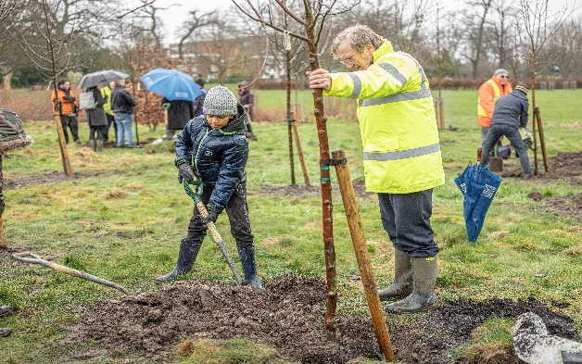
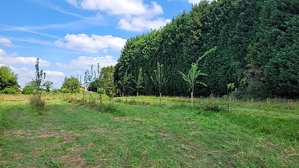

Spotlight: Planting Our Future
Our Pledge
We have pledged to plant 250,000 trees over the next ten years as part of our commitment to tackle climate change via the Planting Our Future campaign. Our tree planting initiative is just one way we want to achieve the target of helping to make the Council carbon neutral by 2030 and the borough by 2041.
The campaign also includes an ambitious plan to enhance and develop the Public Realm through urban greening. Urban greenery helps lessen the impacts of climate change and improves air quality, it also offers health, economic and biodiversity benefits for our communities.

Slide 24
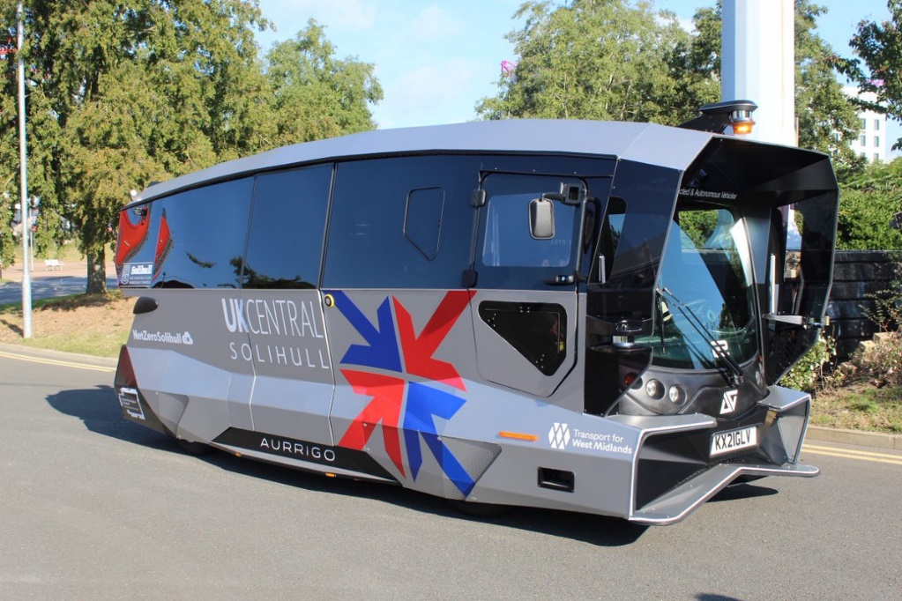
Spotlight: Connected Autonomous Vehicle
Solihull has become one of the first places in the UK to see driverless vehicles take to its roads as part of new ground-breaking passenger trials.
An exciting Council led trial is getting underway to test out how zero carbon Connected Autonomous Vehicles (CAVs) might be integrated into the borough’s transport network in the future
The trial at the NEC will see the shuttle operate autonomously along a 1-mile pre-mapped section of Pendigo Way between Hall 5 and Resorts World.

Slide 25
Getting involved

Slide 26
Ideas of Actions
Out and About
Walk/ Cycle / Scoot where you can
Electric Vehicles, alternative fuel vehicles
Warmer more efficient home
Use heating controls
Insulate your home
Lifestyle
Reduce, Re-use, recycle
Reduce meat and dairy consumption, Locally sourced, seasonal or sustainably produced food
Public Transport
Draught Proofing
Upgrade heating system
Low Energy lighting
Energy Efficient Appliances

Slide 27
Some links to help
Act on Energy -free energy efficiency advice for Solihull residents: https://www.solihull.gov.uk/Housing/Energy-efficiency
Energy Savings Trust: lots of tips on how to reduce carbon emissions: https://energysavingtrust.org.uk/
Waste: https://www.wwf.org.uk/reduce-waste
Planting our Future: https://www.lovesolihull.org/plantingourfuture

Slide 28
Thank you

