Slide 1


Slide 2
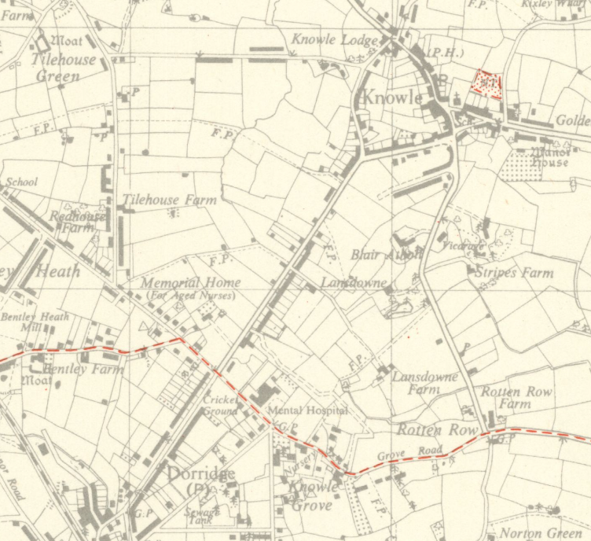
1942

Slide 3
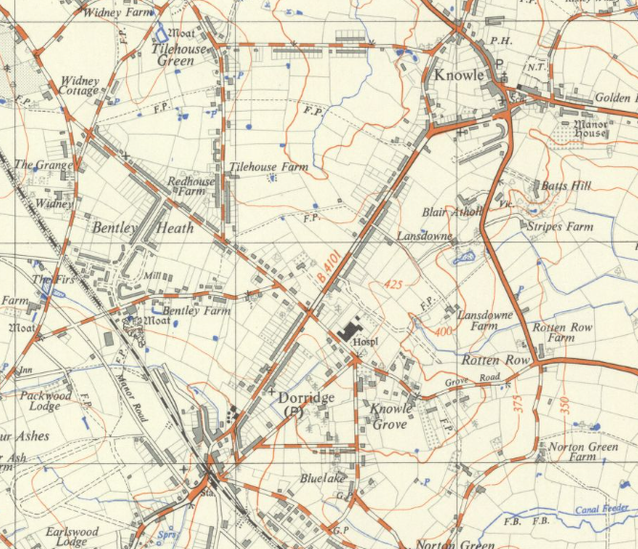
1957

Slide 4
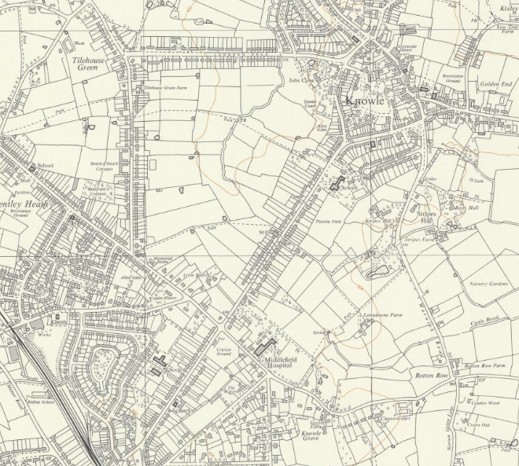
1968

Slide 5
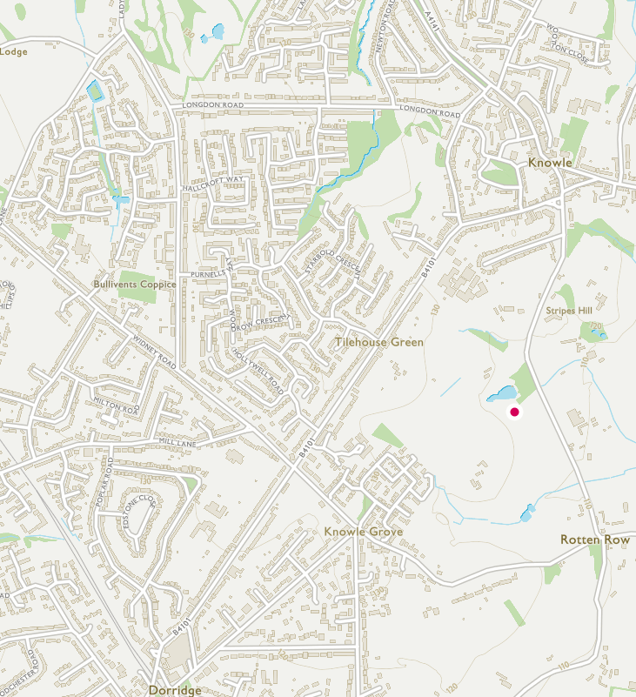

2020

Slide 7
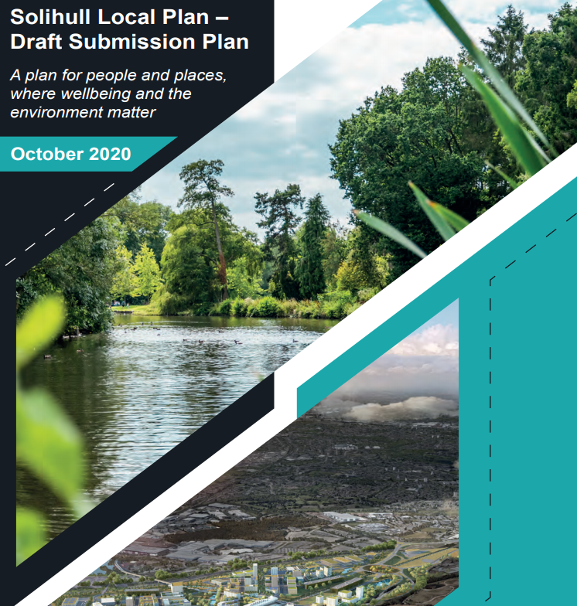

Slide 8
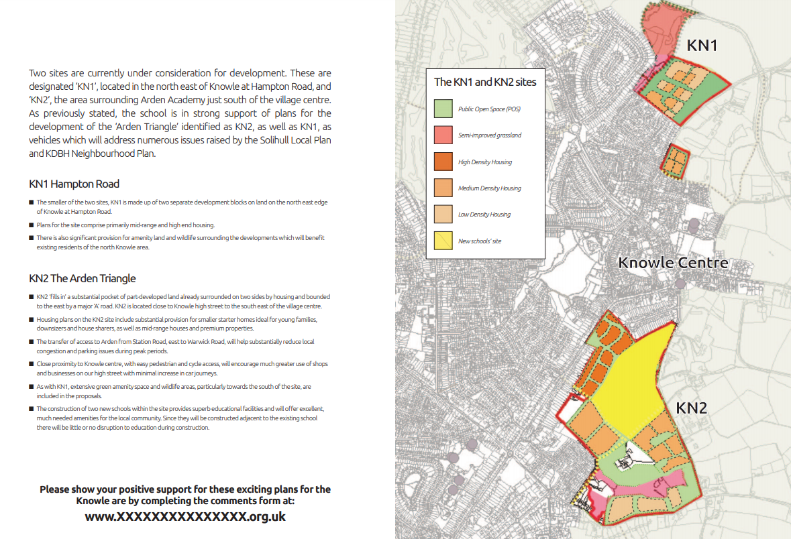

Slide 9
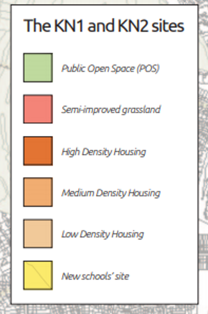

Slide 10
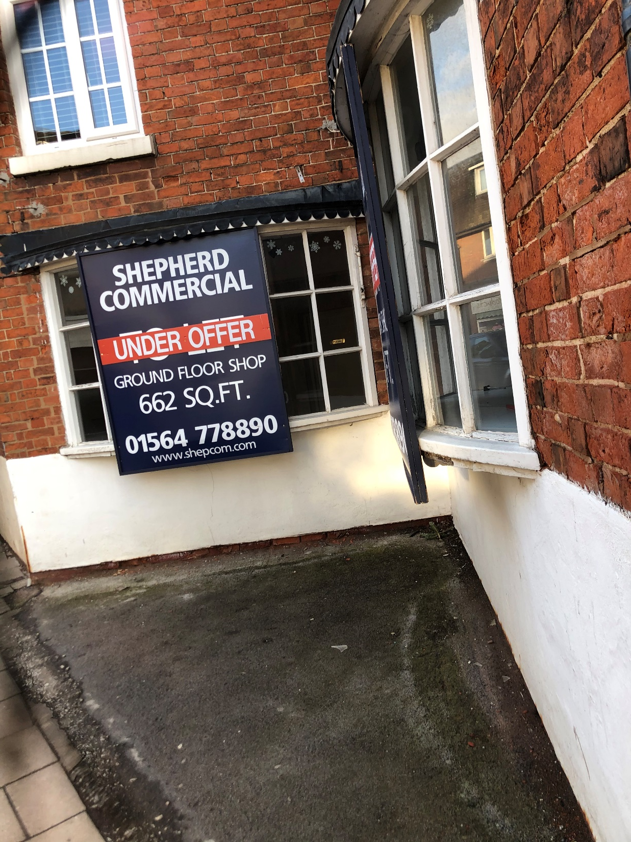

Slide 11
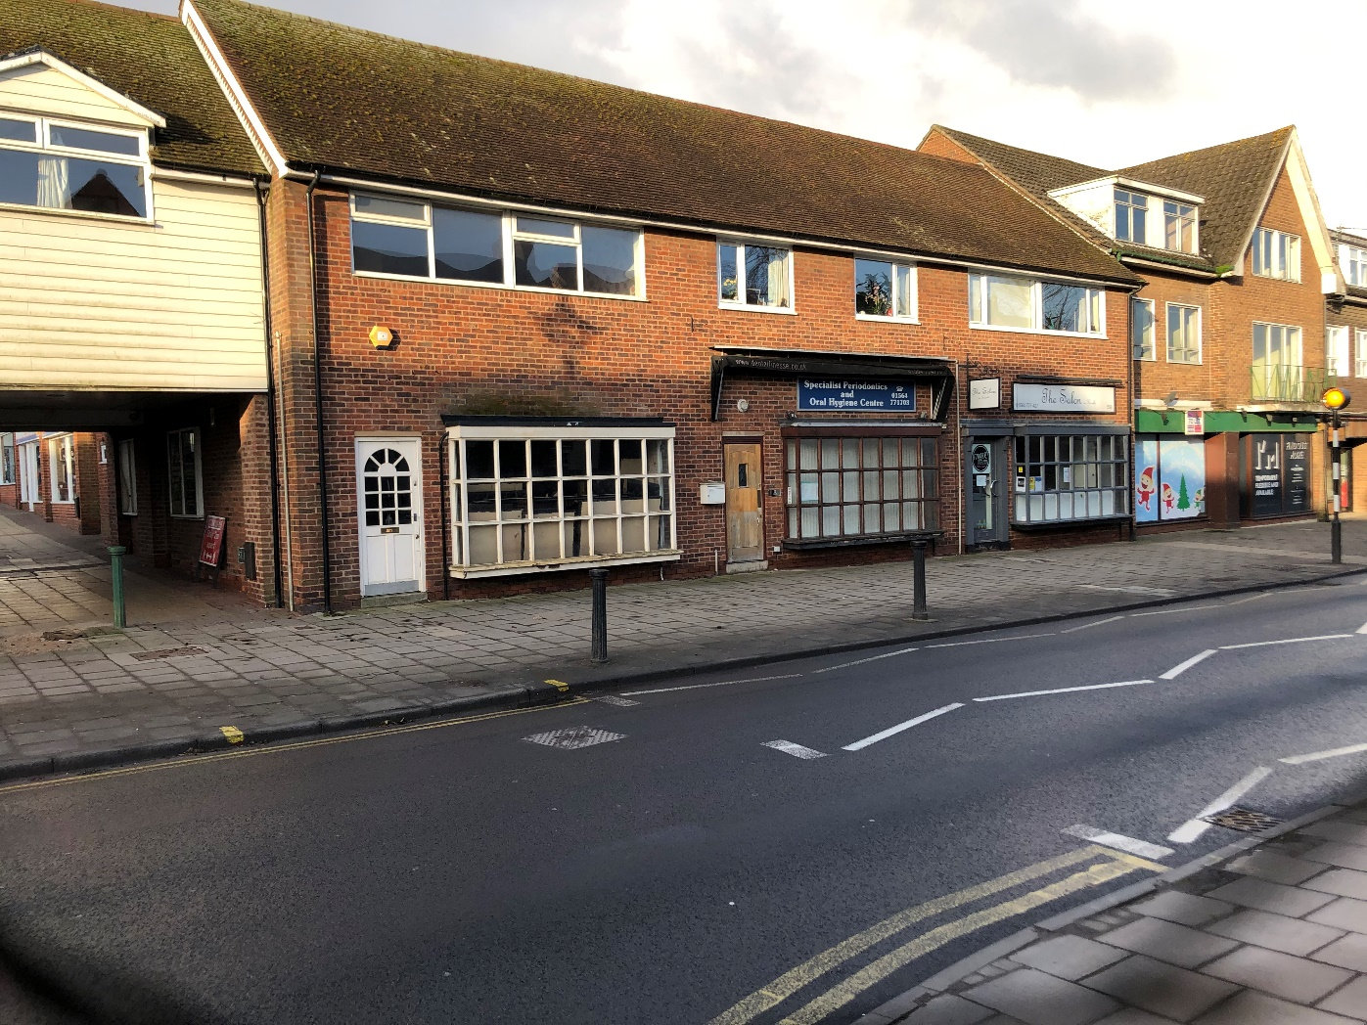
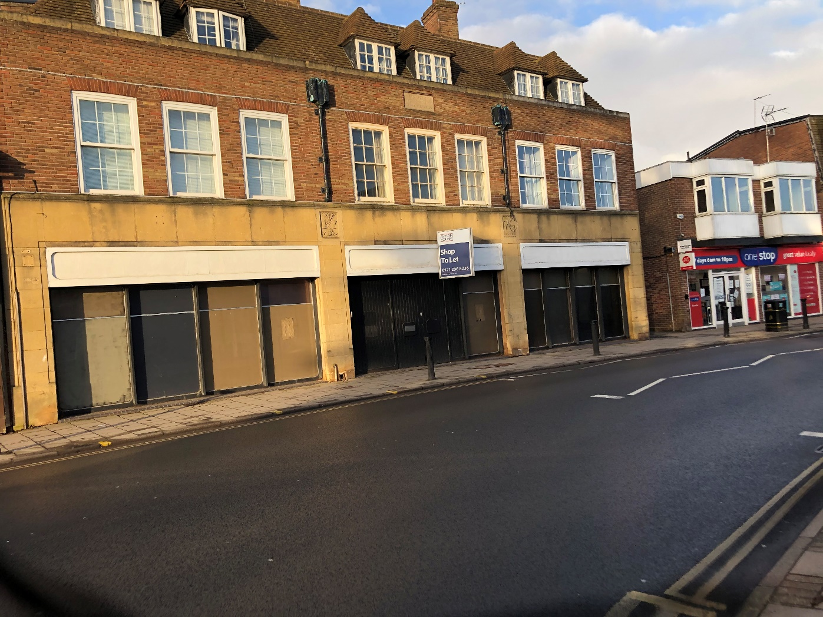

Slide 12
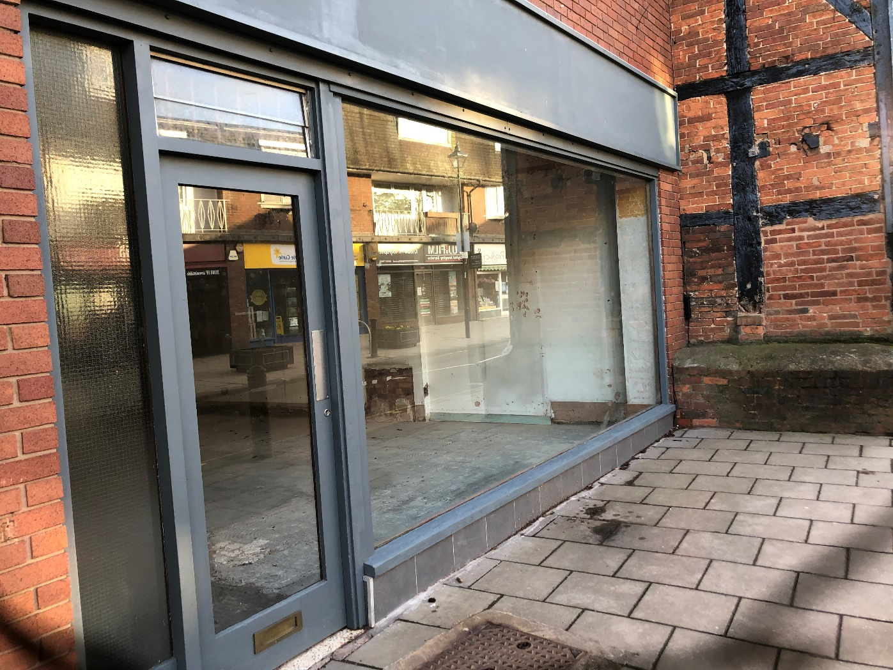
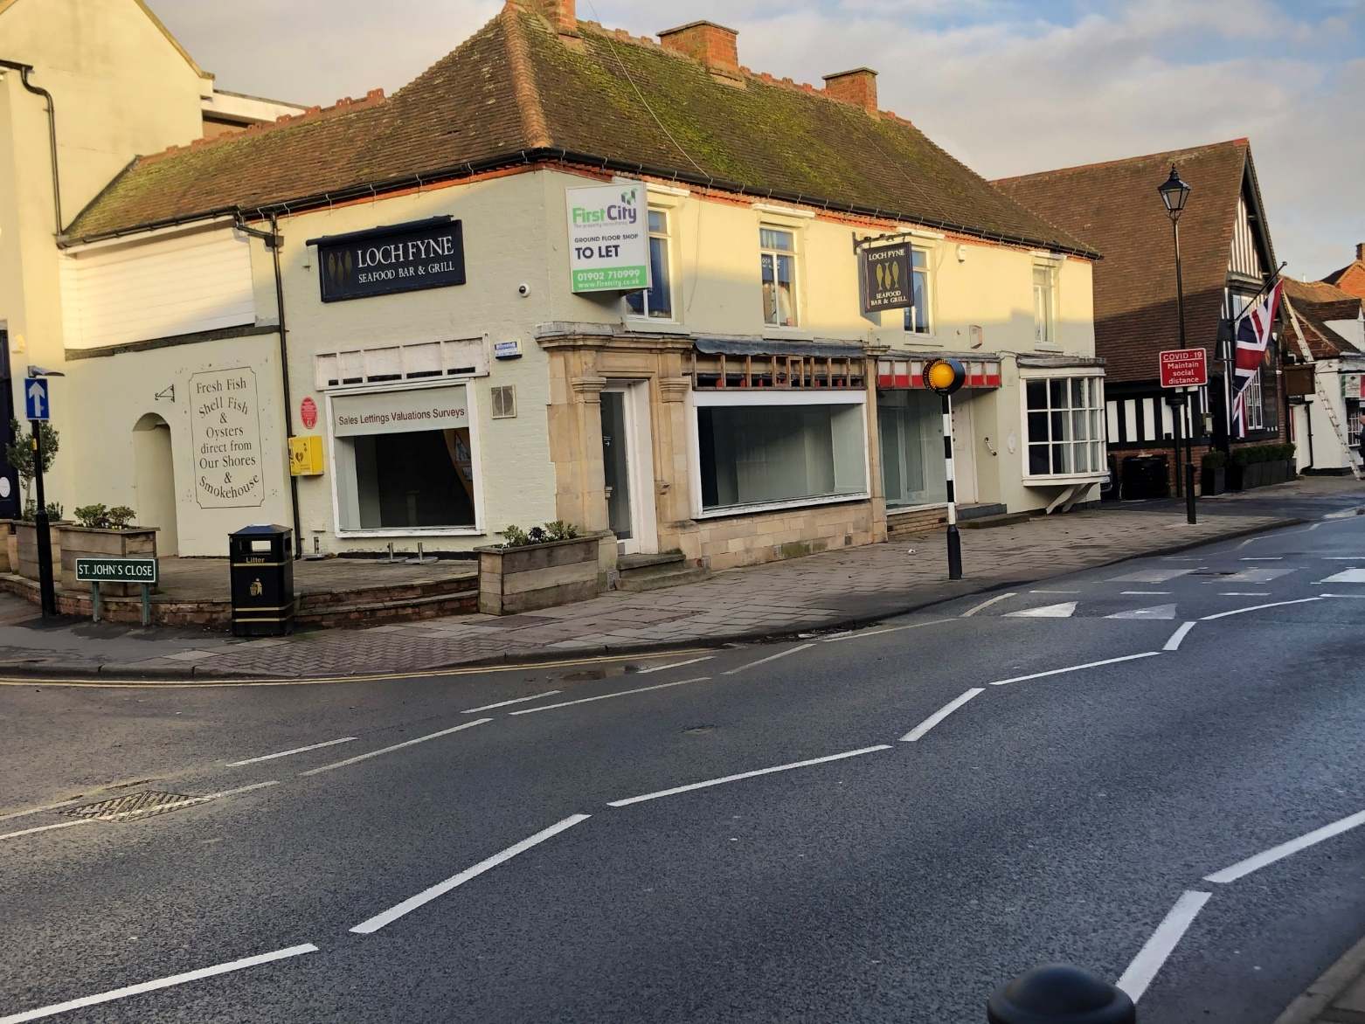

Slide 13
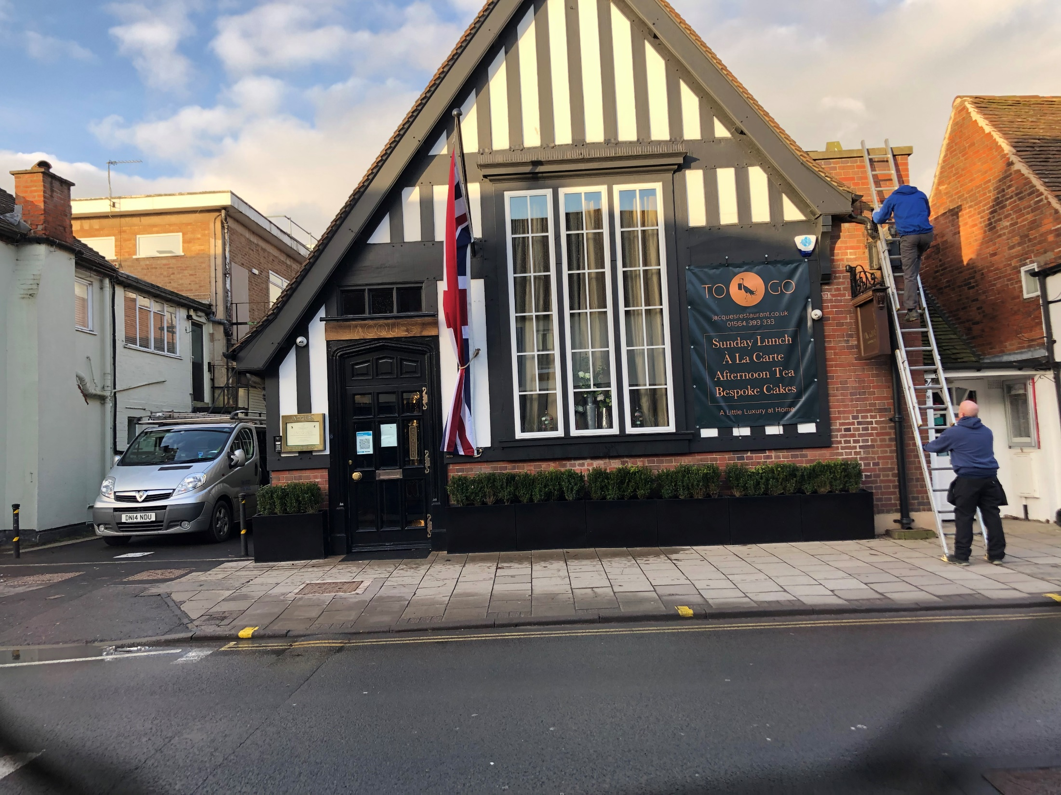

Slide 14
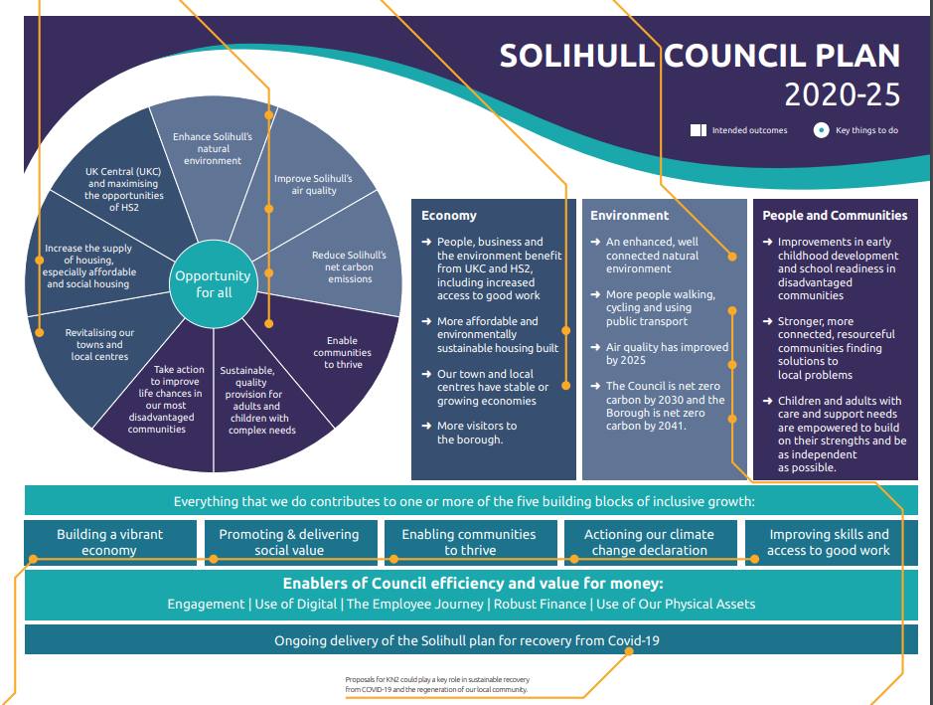

Arden’s proposals are fully in line with the five building blocks of inclusive growth
Proposals for KN2 could play a key role in sustainable recovery from COVID-19 and the regeneration of our local community

Slide 15
Chance of a life time opportunity

Slide 16


The Case for The New Arden Academy A Centre for Community Learning
There is a compelling viable case illustrating why the retention of the existing school is not a realistic solution, in terms of realising medium and long term educational, social and economic benefits for the local community
It is proposed that the development value* of the existing school site is used to help secure the capital investment needed for a new school with additional community facilities
The project also depends on sufficient housing development within the Arden Triangle to help finance it
* The realisable land value of the school site would not represent a gift
from the Council to the Academy. The existing school land value is not
actually realisable by the Council because the school has a 125 year lease
on the land.

Slide 17
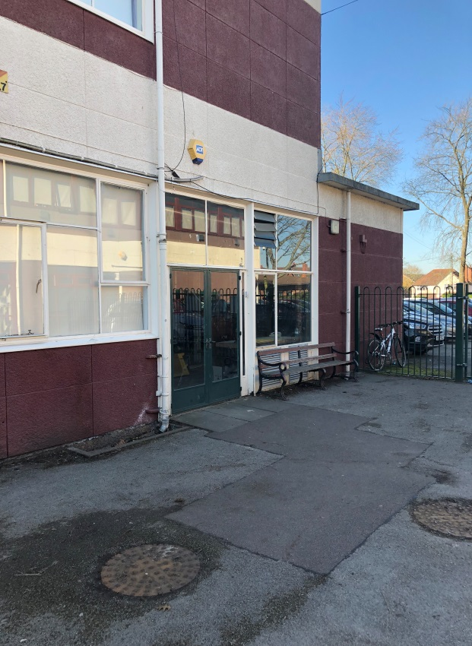
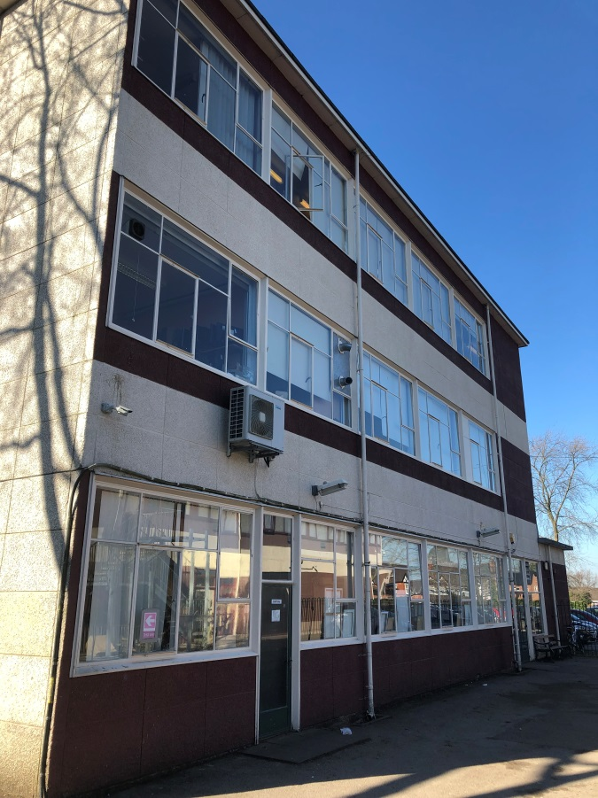
The Current Arden Academy Buildings and Facilities
One of the country’s highest performing academies
Rated as “Outstanding” by Ofsted
But:
The bulk of our premises are no longer fit for purpose and hinder the potential for student attainment and wider community use
The school was designed as 4 FE, then an 8 FE. It is now a 10 FE
Much of the site is over 50 if not 60 years old. For example, the school hall, main teaching blocks, library and dining area are largely the same as when built in 1957/8
Further rejuvenation and renovation is no longer possible or cost efficient
Energy efficiency of the building is poor due to single glazing and poorly insulated cladding
The facilities for the wider community are very limited
The investment required to update our present site is at least £18m. These sums of money from the public purse are no longer available; even if they were, Arden would be a building site for over 10 years, actually hindering student attainment
The EFSA Survey undertaken in 2013 identified the following elements of the main school blocks that would fail sooner: electrical power and lighting; heating; water systems; IT and communications infrastructure; drainage; gas distribution and all external doors and windows

Slide 18
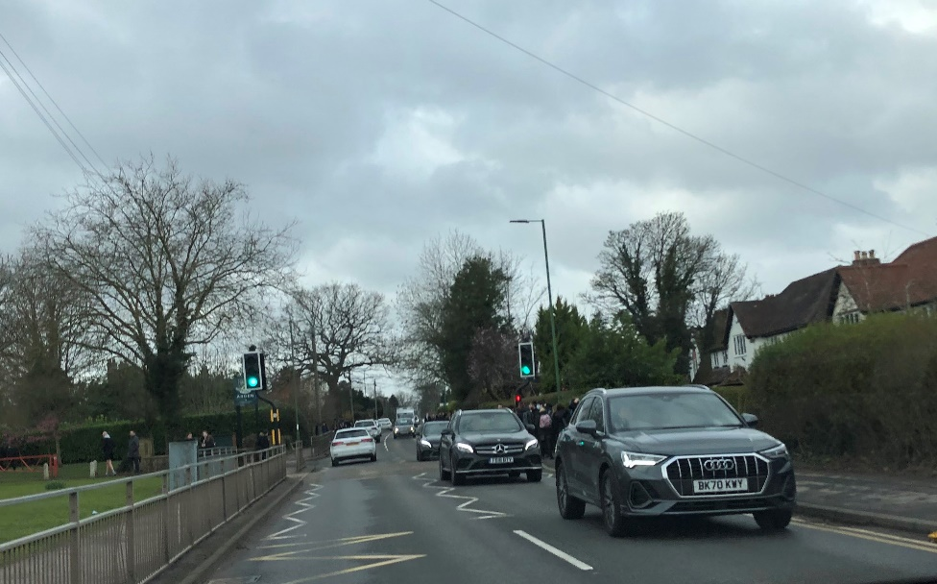
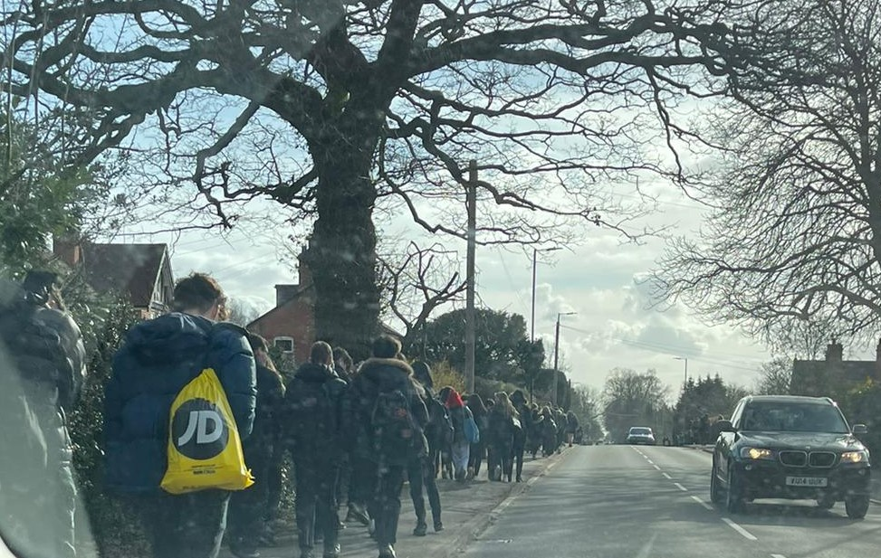
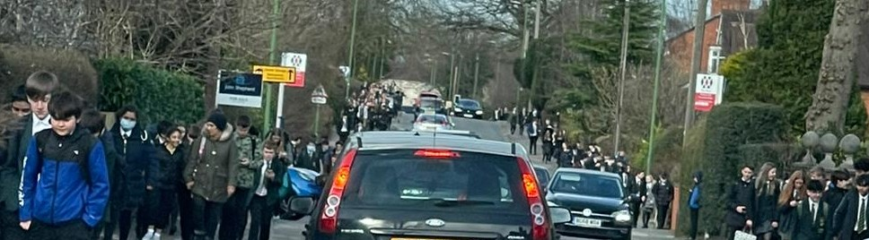
Current Traffic and Pedestrian Safety Issues
School site designed for 500 pupils. Now 1804 students plus over 200 staff arrive and leave the site every day
Major safety concerns on Station Road - another pedestrian crossing needed
Growth in trees and hedgerows mean pavements are narrower
Council aware of significant congestion outside school on school days. Tailbacks delay journeys to work
Traffic calming measures being reviewed/ SMART road markings
No parking on site for parents in evening/ no drop off points
6 reported near misses last year. (Pupils hit by cars and buses)
The Local Neighbourhood Plan refers to traffic issues
Any building work on site requires vehicle access, affecting school operations
A long term traffic and infrastructure plan is needed
New school will create a rolling road and better
traffic management and safer access for students
via 4 or 5 points of access away from main roads

Slide 19
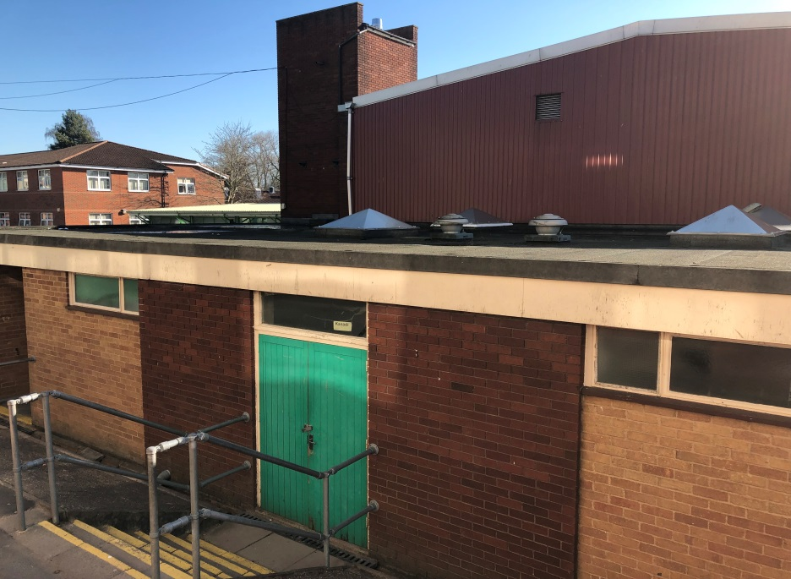
Current Lack of Community Sport, Health and Social Facilities
No gym or swimming pool at the school
Nearest swimming pool is Tudor Grange- 4 miles away in Solihull
Not an easy journey so since no direct bus
Nearest gym is Virgin at Blythe Valley Park .
No floodlit full size Hockey/AstroTurf pitch at the school
Above issues identified in KDBH people survey and Neighbourhood Plan
Community meeting facilities - School hall is too cold Community groups use church hall and scout huts (but size restrictions limit use and larger buildings often fully booked)
No Youth Centre for the young people in our local community to attend – to be safe; be active and learn and where they can meet new friends, discover new interests and develop their mental, physical and social skills

Slide 20
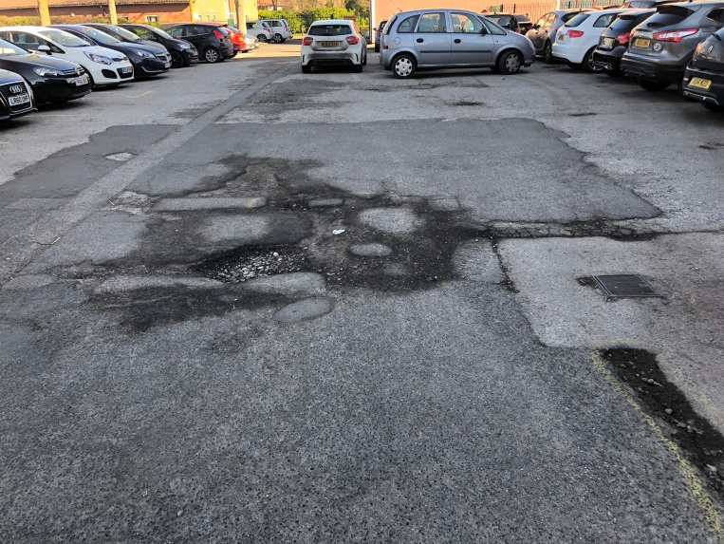
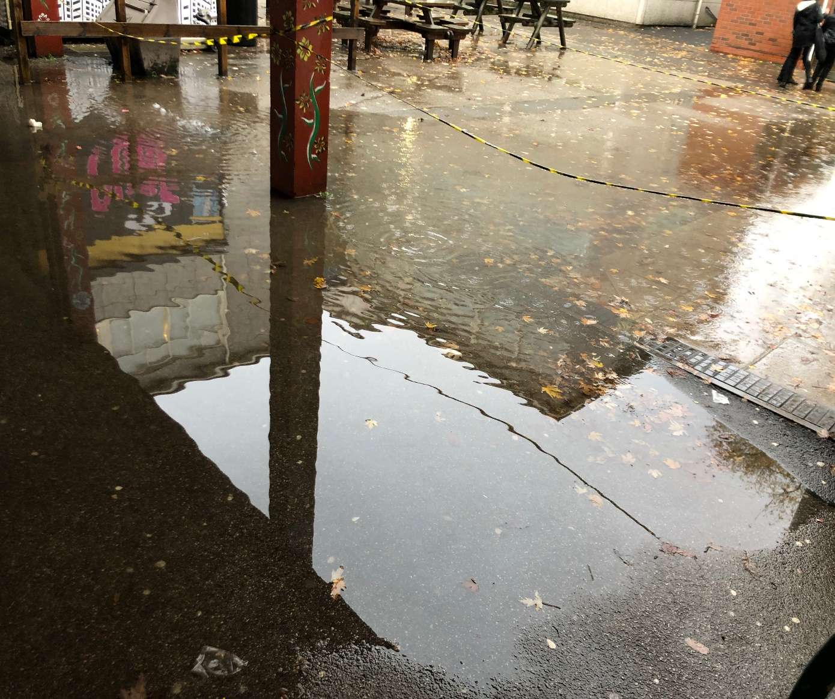
Current Poor Basic School Infrastructure
75% of the school is in need of refurbishment
Continuing drainage problems which cause flooding
Heating - Hot rooms in summer / cold in winter
Regular M&E crashes . Recent 2 day heating outage
Electrics / cabling / inability to add electrical data points/ electrical capacity/ pods/ and lighting mean classrooms are unsuitable for latest IT equipment
Old M&E running costs are over £100k p.a. more than a modern building
Carbon emissions are very high
Dining Area is not fit for purpose
School Hall in very poor shape for productions and assemblies – it
is no longer big enough to house 2 Year groups for assemblies
There is no 6th form library
No suitable place for 6th form to eat

Slide 21
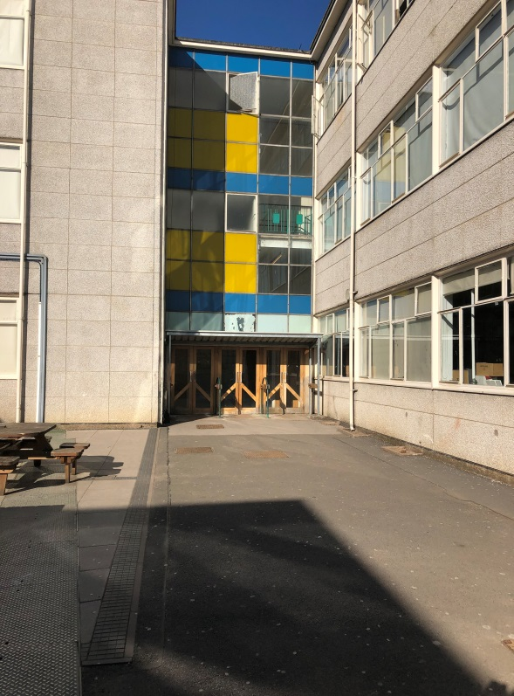
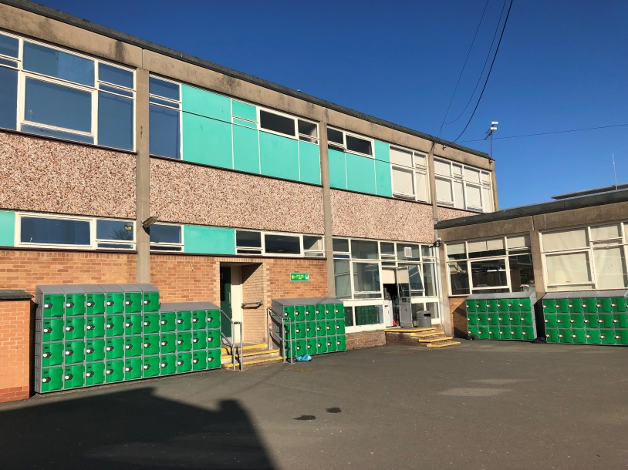

Slide 22
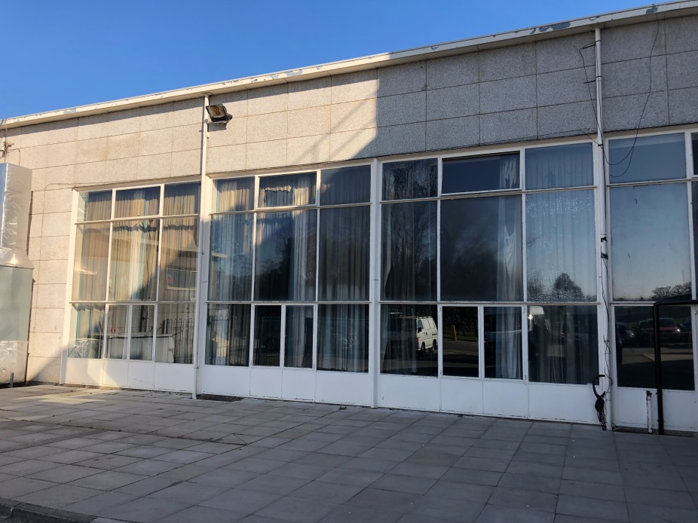
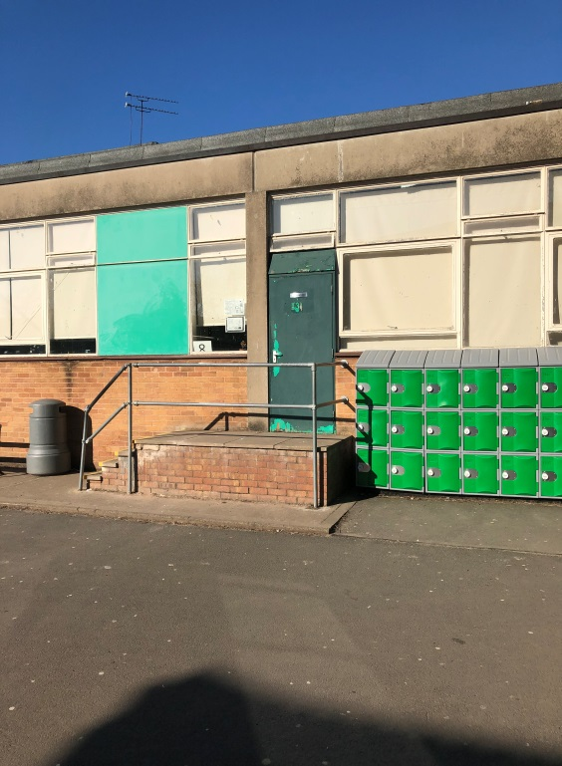

Slide 23
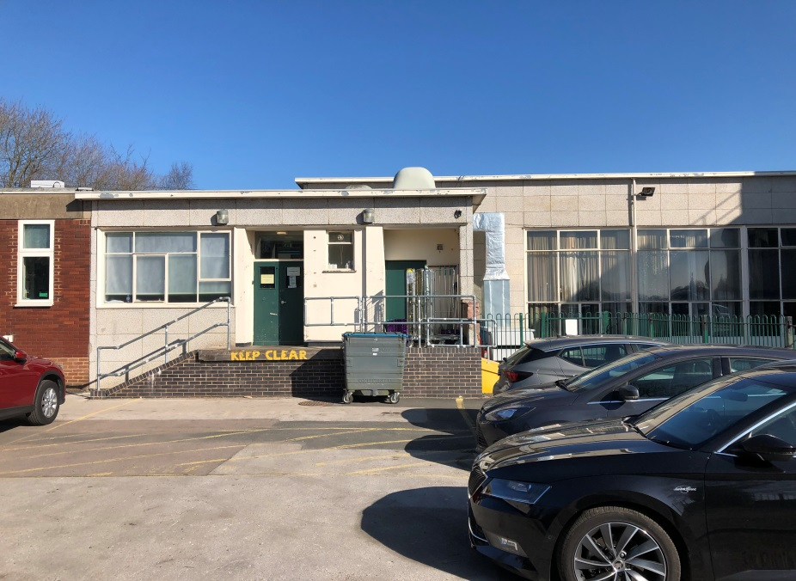
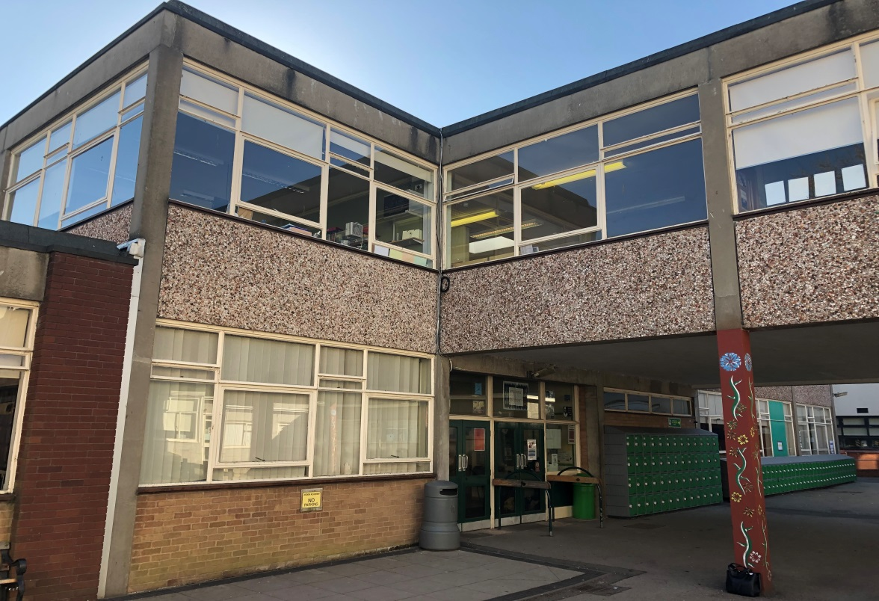
Current Impact of School Condition on Teaching and Learning
School rooms have 96% usage rate
School hall cannot accommodate full assemblies
Dining Hall - 1800 on site but hall can only accommodate 120 seated
Exams in hall - noisy ( next to kitchens)
More exam spaces required
Space for PE and Sports is used for teaching and examinations
Acoustics poor for concerts
Location, number and conditions of toilets is poor
Not a pleasant eating environment
No dry outdoor social space
Food queuing outside
Changing facilities and space is poor
Public footpath across the site; significant safeguarding issues and vandalism.
Not enough high quality science labs
No room for lockers inside
75% of school is not accessible to disabled people
No hearing loops due to unsuitable infrastructure
Pupils get wet when walking between classes
Pandemic has further highlighted these issues

Slide 24
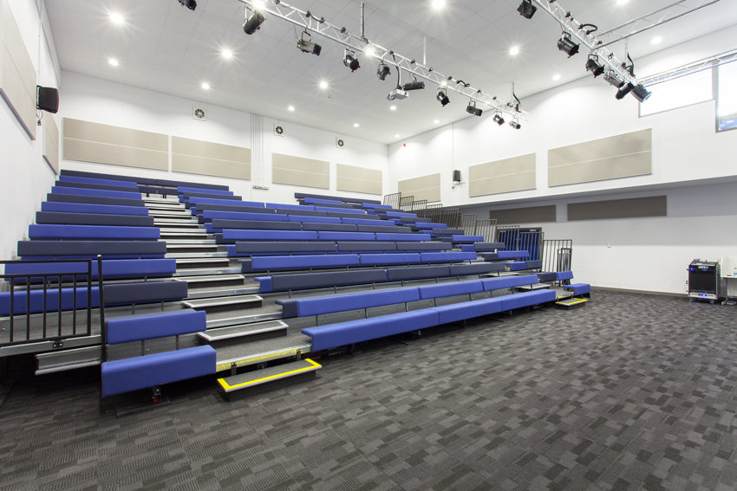
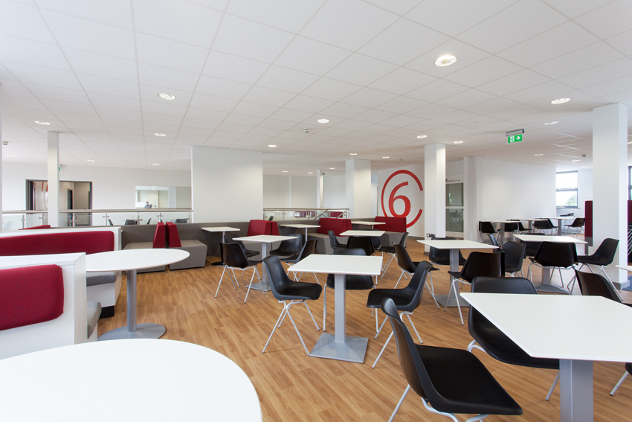
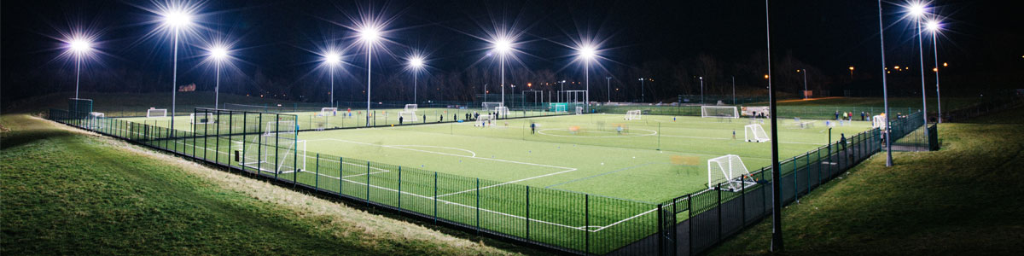
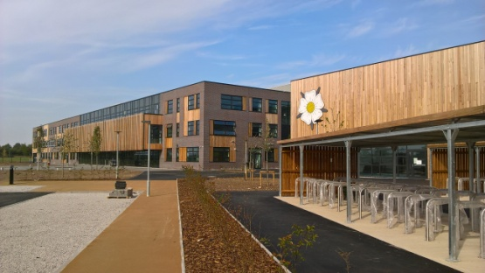
Our Ambitions for the New Arden – A Centre for Community Learning
A New Arden with modern features that will realise the incredible potential for student attainment and wider community use
A new 3 storey school to accommodate the anticipated growth of sixth form students
600 seat Performing Arts Theatre
Swimming Pool, Gym and Sports Centre
4G floodlit pitch and MUGA
Gymnastics Centre
Day Nursery
Youth Centre
A co-located new Primary School to share facilities
There will be full community use and the opportunity to engage young and old alike.

Slide 25
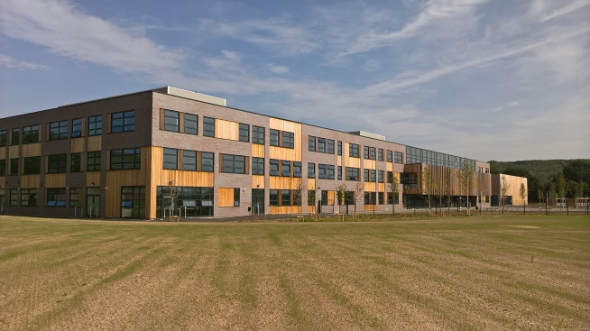
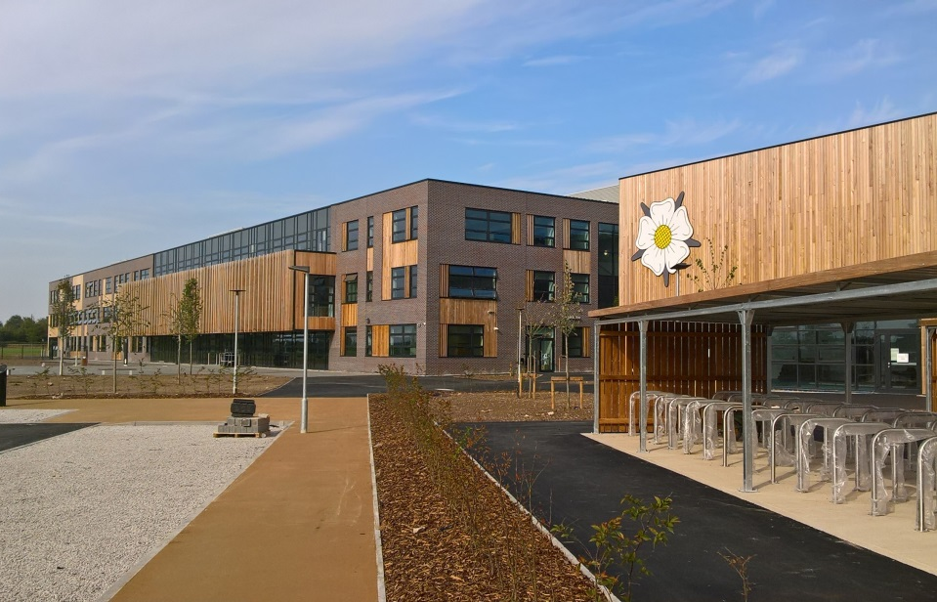
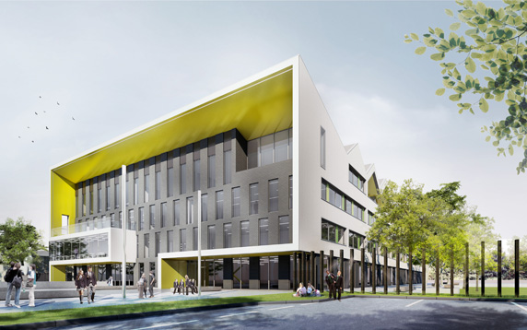

Slide 26
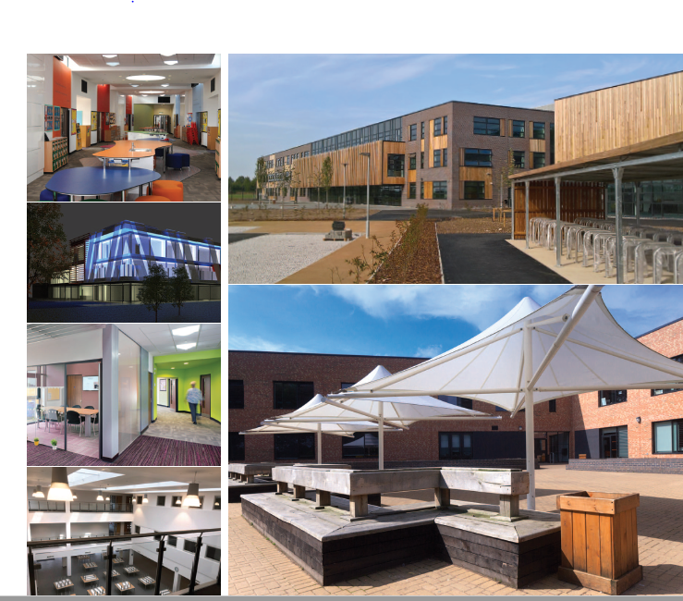

Slide 27
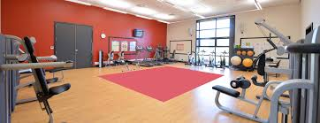
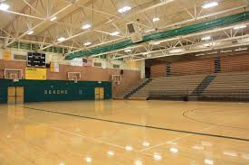
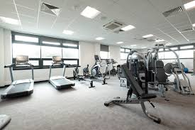
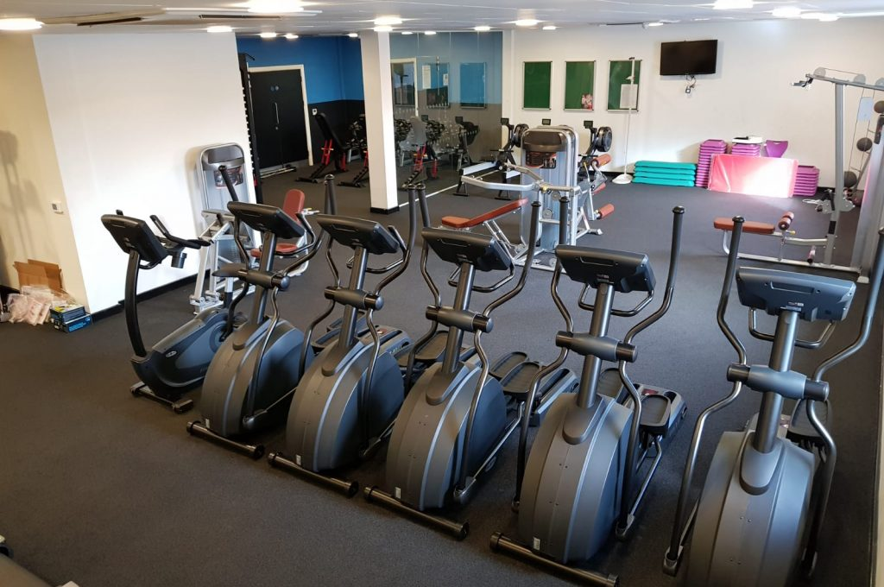
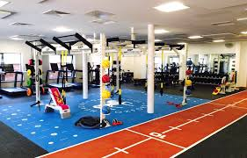

Slide 28
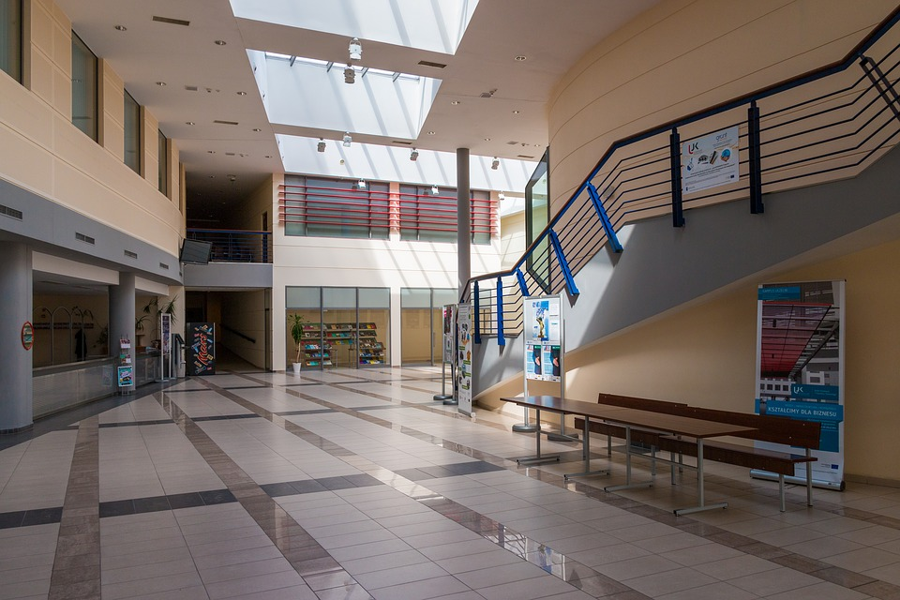
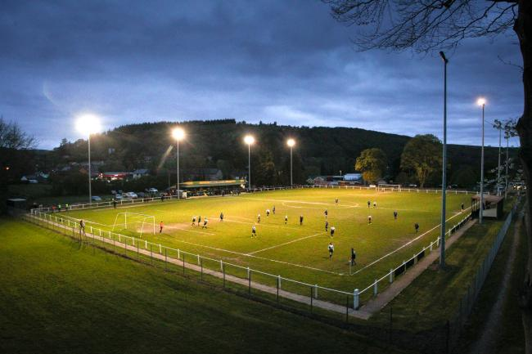

Slide 29
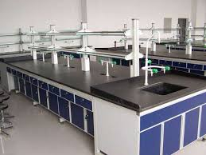
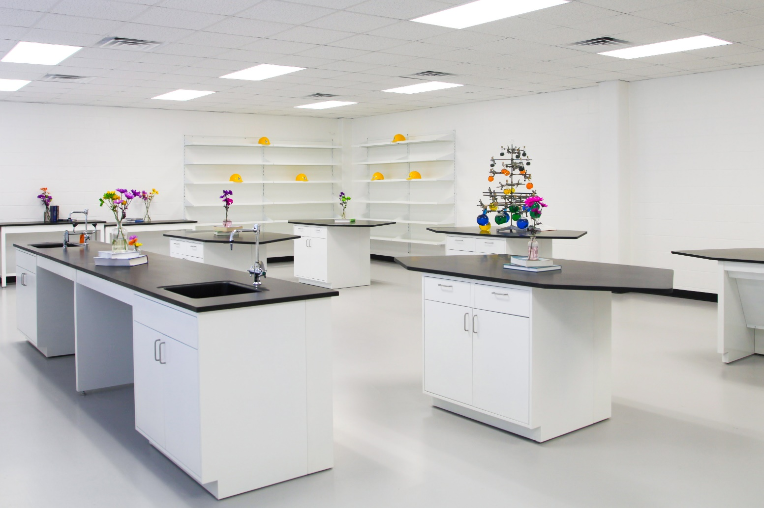
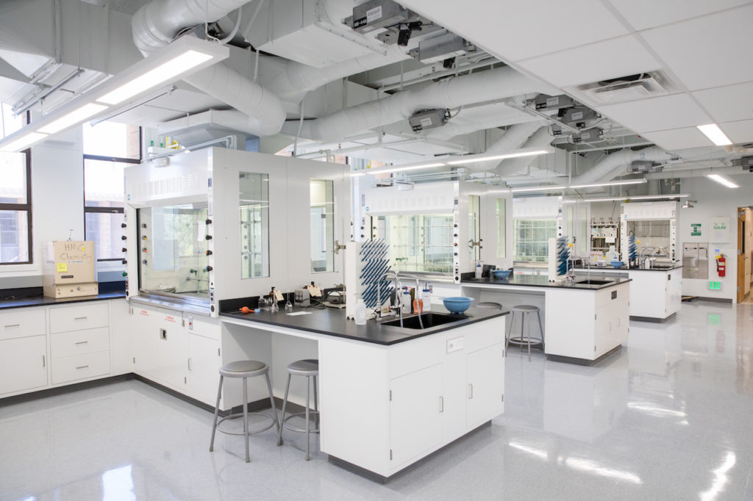
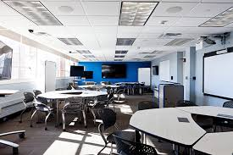
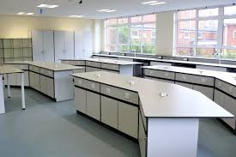
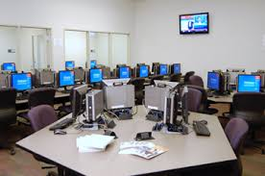

Slide 30
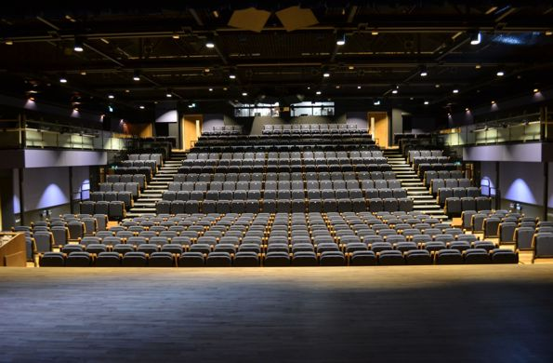



Slide 31




Slide 32

A sustainable site -
Learning
Living and Leisure

Slide 33

Detailed Concept Plan
Access
Primary School
Housing Density

Slide 34


Slide 35
Detailed Concept Plan
Access
Pedestrians and cycle ways
Car Parking
Vehicles
Sport
Primary School

Slide 36





The new schools will help reduce Solihull’s net carbon emissions and fully support SMBC’s ‘Net Zero Carbon’ target for 2030.
We already know modern insulation and heating will cut Arden’s CO2 emissions by over 60% and the annual energy bill to less than half current costs, saving in excess of £50k per year.
Nevertheless, it is our aim to achieve even greater efficiencies through use of the
most up-to-date technologies, making the new, sustainable Arden -
A Centre for green technology in the West Midlands.
A new, greener, more sustainable Arden

Slide 37
Our Vision: The Benefits for Our Community
A new state of the art School and Centre for Community Learning
Better Community Safety when travelling to and from school
Significant reduction of traffic on school routes
New Youth Zone – where young people will be safe; be active and learn and where they can meet new friends, discover new interests and develop their mental, physical and social skills
A reduction in the school’s carbon footprint - reduced energy consumption and costs
Better sport, music, drama, leisure and learning facilities for the whole community during and outside school hours
Supporting growth, regeneration and rejuvenation of the local area and related infrastructure

Slide 38
‘Chance of a life time’ opportunity -
KN2- We can together create for our community:
Living
Leisure and Learning
Regeneration
Rejuvenation
Sustainability

Slide 39
For further information
Contact Michele Bull 01564 732613
mbull@arden.Solihull.sch.uk
Or visit www.arden.solihull.sch.uk
Thank you for letting me share our ambitions and plans this evening
Martin Murphy
Back to Dave and I guess any questions?

